Slide 1


Toronto Restaurant Recommender System
Presented by Jiangning Luo and Hang Gong

Slide 2
Contents
1
Introduction
2
Data Pipeline
3
Data Models
4
Evaluation
5
Showcase & Summary
Toronto Restaurant Recommender System
Presented by Jiangning Luo and Hang Gong

Slide 3
PART 1
Introduction
Toronto Restaurant Recommender System
Presented by Jiangning Luo and Hang Gong

Slide 4

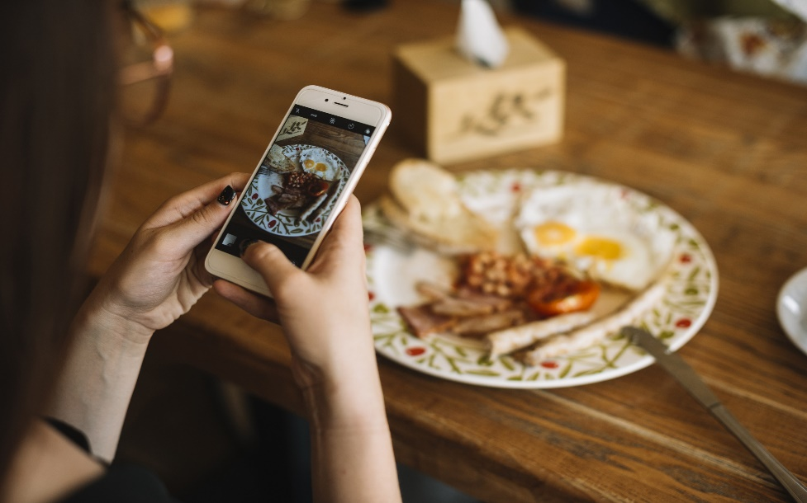

Introduction
Motivation
Goal
Method
There are thousands of restaurants in Toronto City. Sometimes, it is hard for consumers to decide which one they should visit.
Build a personalized recommendation system for the Yelp users in Toronto, recommend the most suited restaurants for the yelp users.
Modelling users’ performance on items based on their past interactions. Using the neural collaborative filtering, compare it with classical matrix factorization.
Toronto Restaurant Recommender System
Presented by Jiangning Luo and Hang Gong

Slide 5
PART 2
Data Pipeline
Toronto Restaurant Recommender System
Presented by Jiangning Luo and Hang Gong

Slide 6
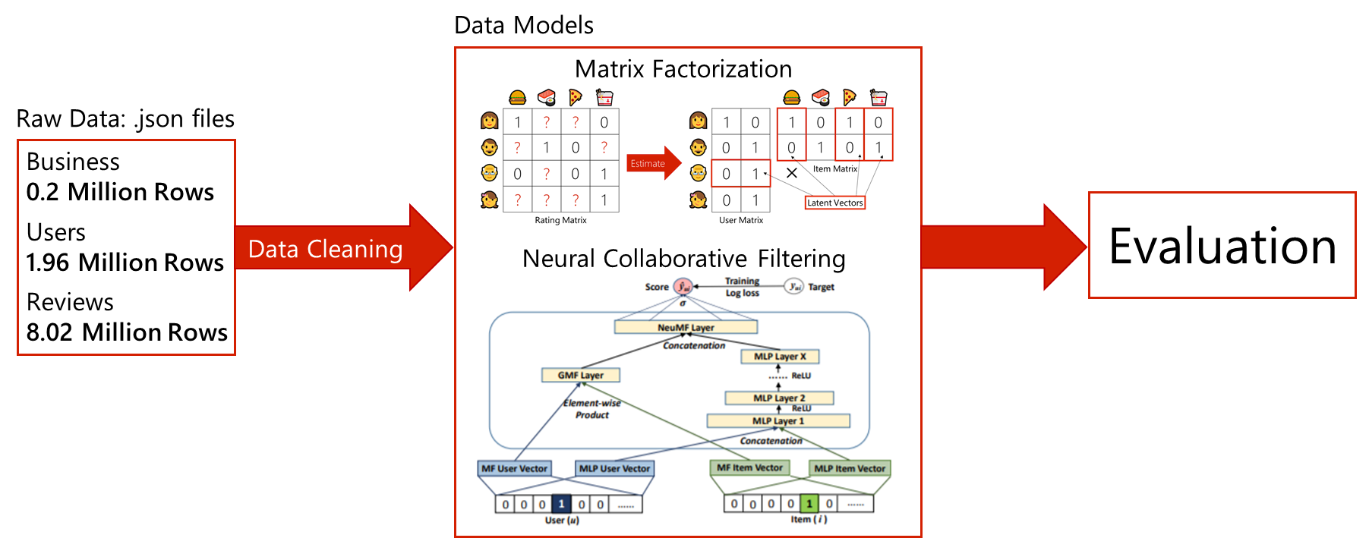
Data Pipeline
Toronto Restaurant Recommender System
Presented by Jiangning Luo and Hang Gong

Slide 7
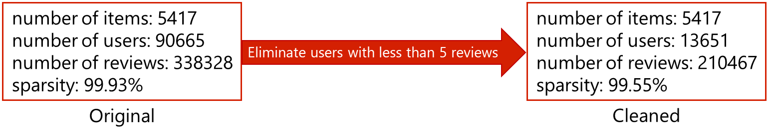
Data Pipeline
Data Cleaning
Keeping the users with only a few reviews leads to a noisy training set and therefore leads to high bias.
Eliminating too much users leads to a small training set and therefore leads to high variance.
The challenge here is deciding the users with less than what number of reviews need to be eliminated.
After the experiments, we decide to eliminate the users with less than 5 reviews.
Toronto Restaurant Recommender System
Presented by Jiangning Luo and Hang Gong
Notes:
As you can see in the picture, after the cleaning, we eliminated a lot of users with a few reviews, but we still have a relatively big dataset to fit the models.

Slide 8
PART 3
Data Models
Toronto Restaurant Recommender System
Presented by Jiangning Luo and Hang Gong

Slide 9
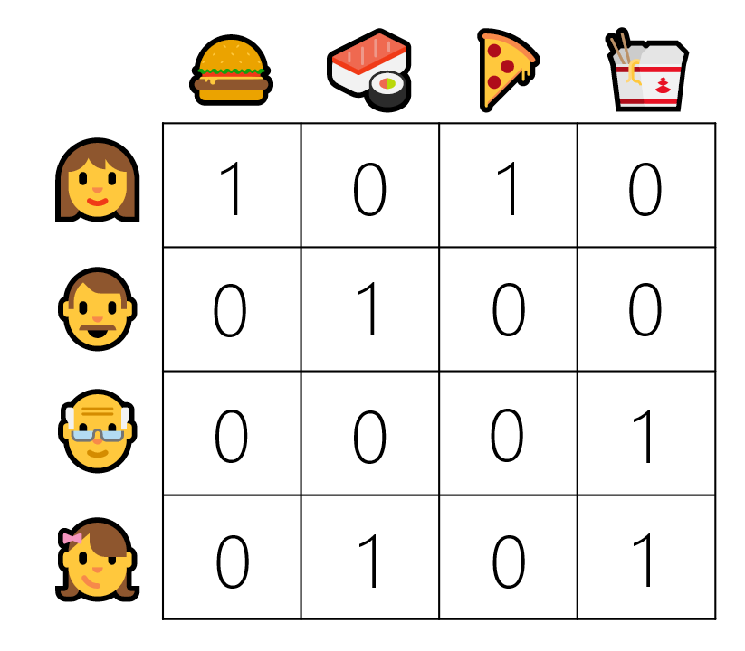
Data Models
Interaction Matrix
We define the interaction matrix from the interactions between the users and the restaurants
1 if the user is interested in the restaurant
0 if the user have no interest in the restaurant
Toronto Restaurant Recommender System
Presented by Jiangning Luo and Hang Gong
Notes:
We define the user-item matrix from the interactions between the users and the restaurants. We denote the interaction as 1 if the user is interested in the restaurant, and we denote the interaction as 0 if the user have no interest in the restaurant

Slide 10
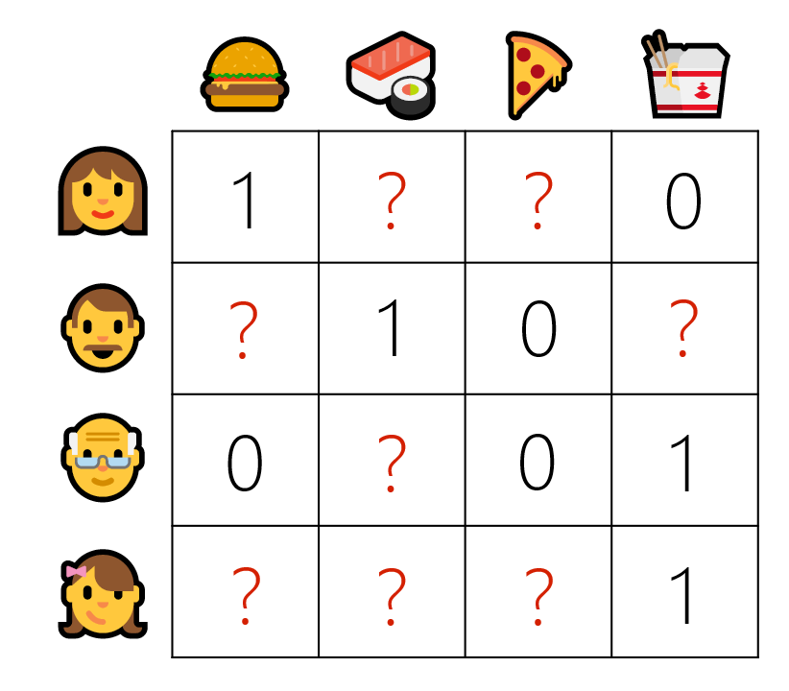
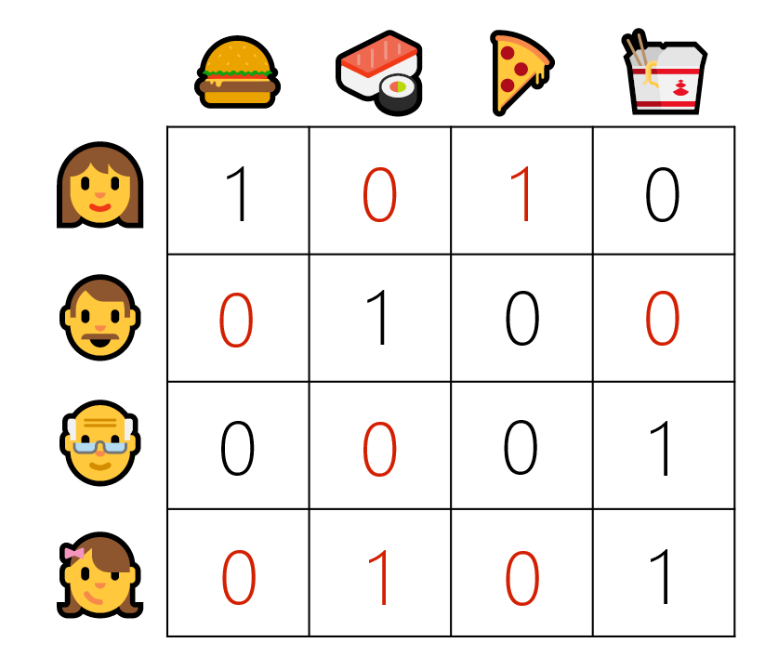
Data Models
Goal of Our Recommender System
Predict
Toronto Restaurant Recommender System
Presented by Jiangning Luo and Hang Gong

Slide 11
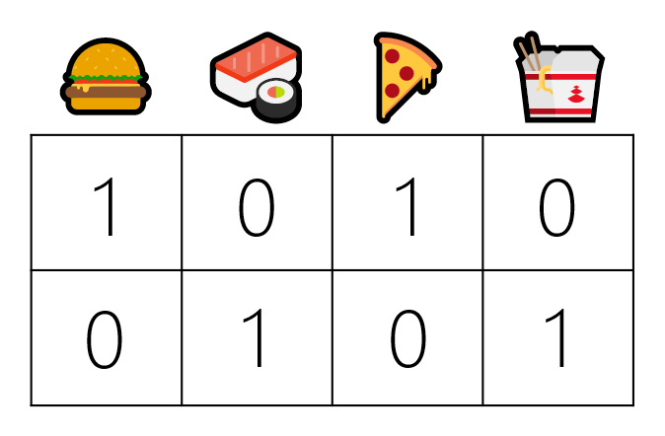
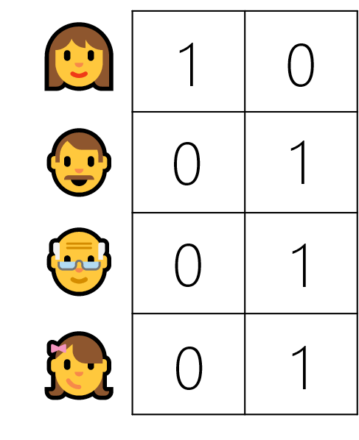

Data Models
Matrix Factorization
Estimate
$$×$$
Item Matrix
Latent Vectors
Rating Matrix
User Matrix
Toronto Restaurant Recommender System
Presented by Jiangning Luo and Hang Gong

Slide 12
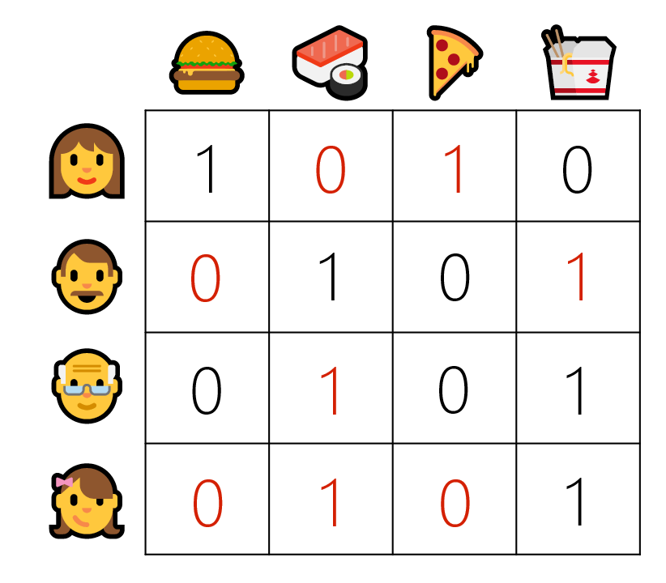

Data Models
Matrix Factorization
$$×$$
Predict
Item Matrix
User Matrix
Predicted Rating Matrix
Toronto Restaurant Recommender System
Presented by Jiangning Luo and Hang Gong

Slide 13
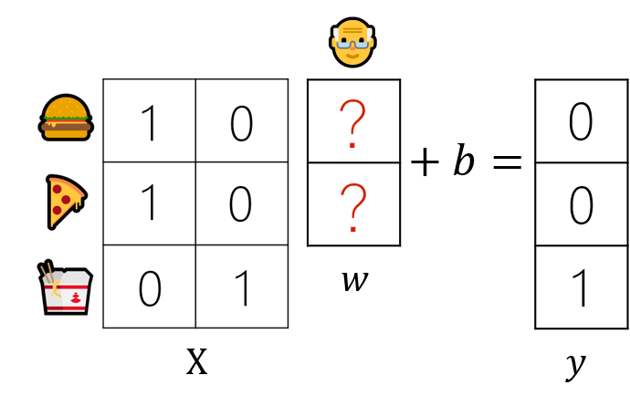
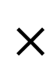
Data Models
Matrix Factorization
The training of matrix factorization is actually training a bunch of linear regression models.
？
？
$$×$$
Item Matrix
User Matrix
Toronto Restaurant Recommender System
Presented by Jiangning Luo and Hang Gong

Slide 14
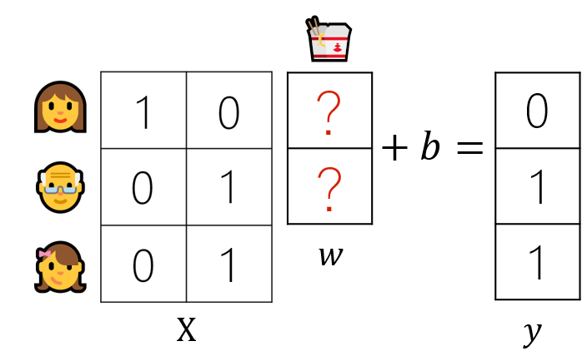
Data Models
Matrix Factorization
Actually, Matrix Factorization problem is a bunch of linear regression problems.
？
？
$$×$$
Item Matrix
User Matrix
Toronto Restaurant Recommender System
Presented by Jiangning Luo and Hang Gong

Slide 15
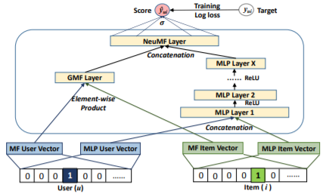
Data Models
Neural Collaborative Filtering
Fusion of generalized matrix factorization (GMF) and multi-layer perceptron (MLP) collaborative filtering.
* Image from Neural Collaborative Filtering by He et. al.
Toronto Restaurant Recommender System
Presented by Jiangning Luo and Hang Gong

Slide 16
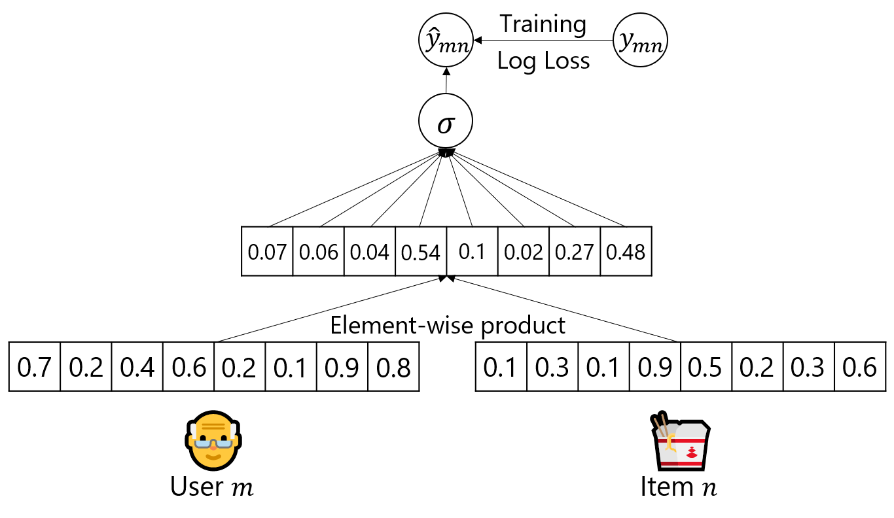
Data Models
Generalized Matrix Factorization
Matrix factorization, but this time it is training a bunch of logistic regressions instead of training linear regressions.
Toronto Restaurant Recommender System
Presented by Jiangning Luo and Hang Gong

Slide 17
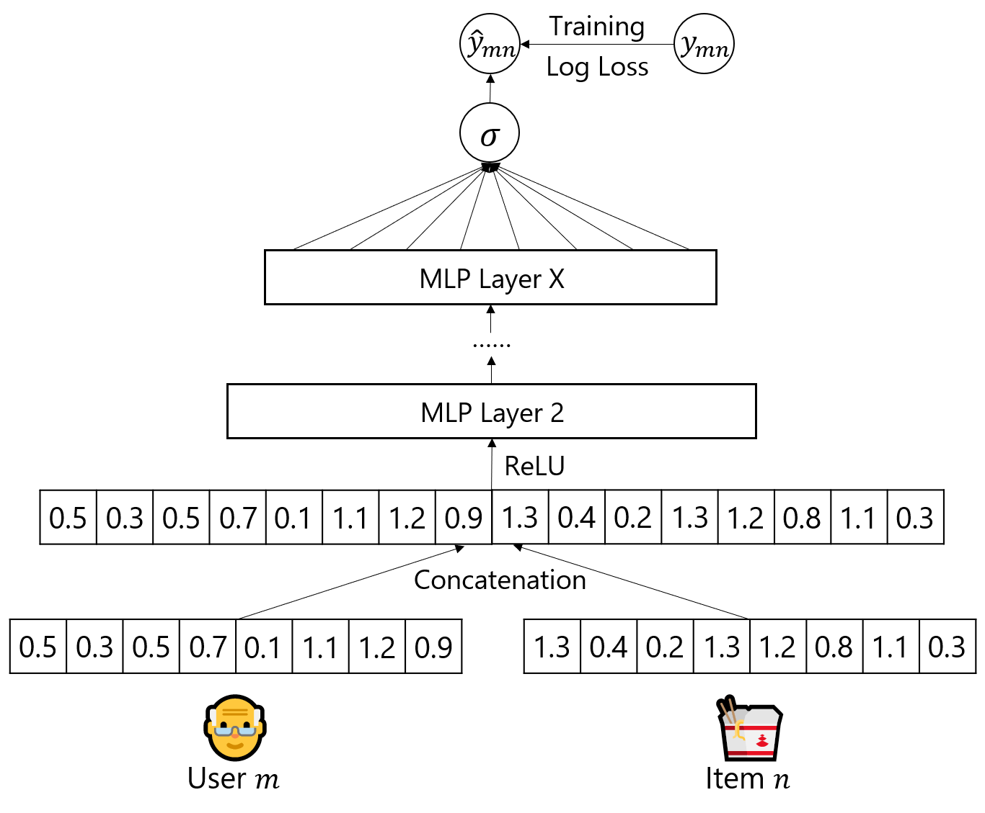
Data Models
Multi-Layer Perceptron
Combine the features of a user and an item by concatenating them, then use multi-layer perceptron to learn the interaction between user and item latent features.
Endow the model a large level of flexibility and non-linearity to learn the interactions between the users and the items, instead of only using a fixed elementwise product in GMF
Toronto Restaurant Recommender System
Presented by Jiangning Luo and Hang Gong

Slide 18
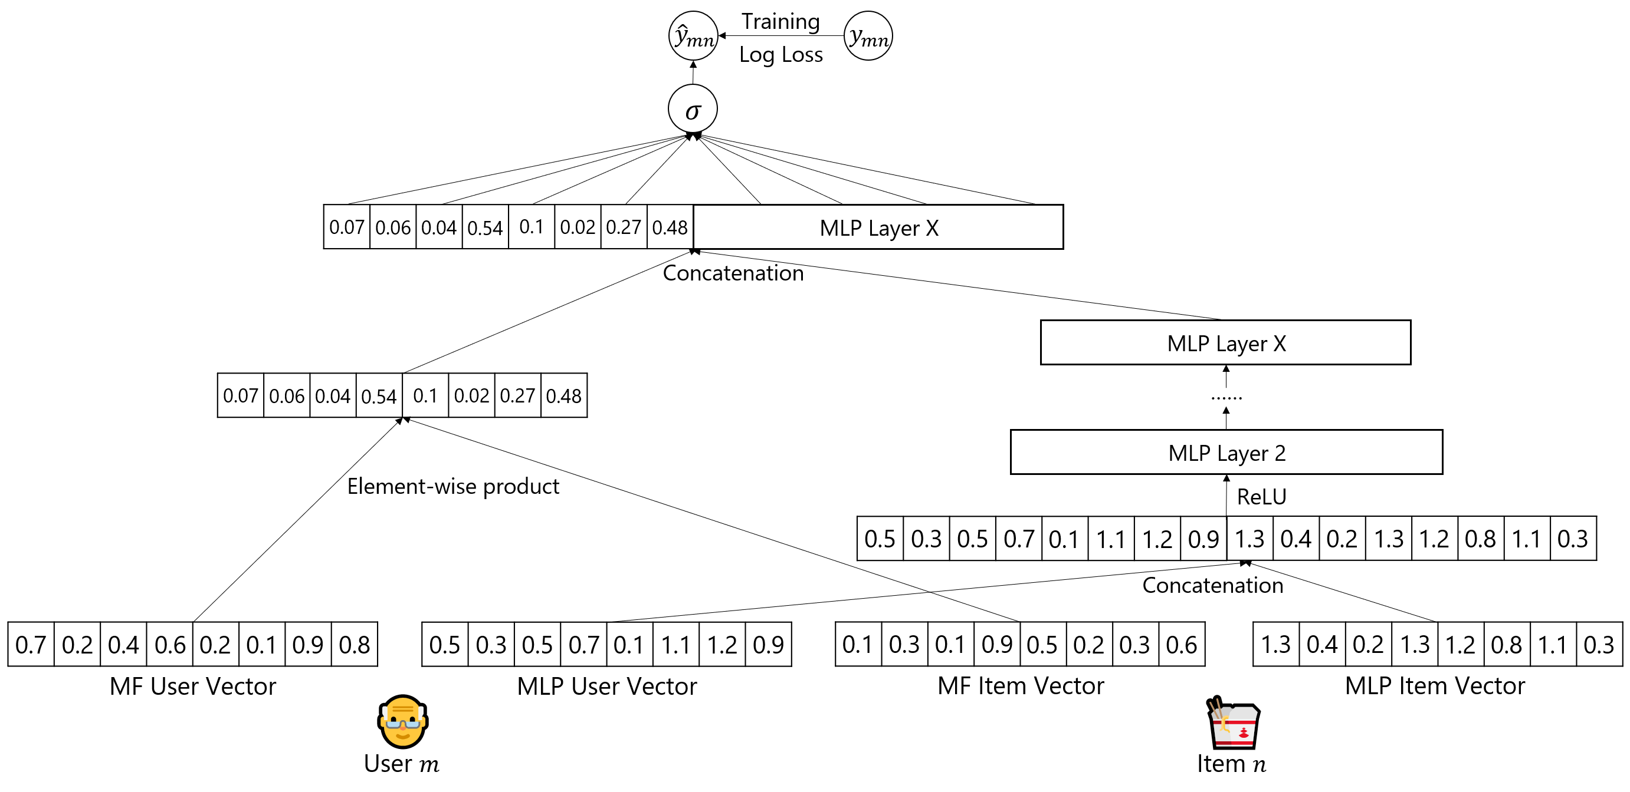
Data Models
Fusion of GMF and MLP
Toronto Restaurant Recommender System
Presented by Jiangning Luo and Hang Gong

Slide 19
PART 4
Evaluation
Toronto Restaurant Recommender System
Presented by Jiangning Luo and Hang Gong

Slide 20
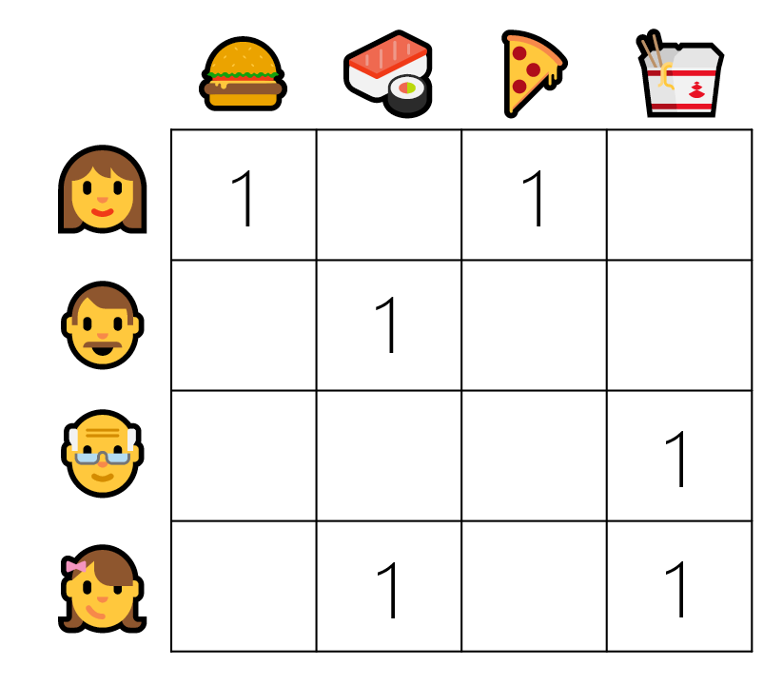
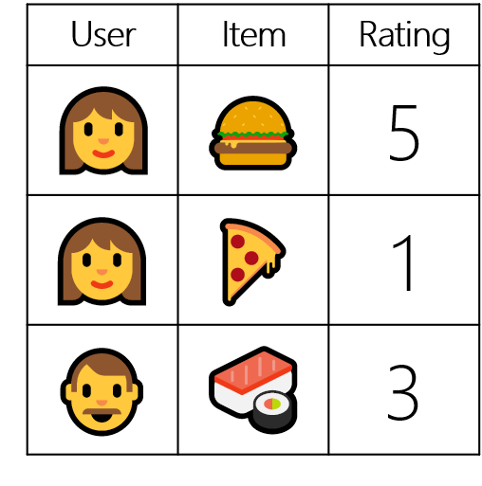
Evaluation
Interested vs Not Interested
If a user gave a restaurant a review, we assume the user is interested in the restaurant.
If a user haven’t reviewed a restaurant, we assume the user is either not interested in that restaurant or have not aware of that restaurant.
Toronto Restaurant Recommender System
Presented by Jiangning Luo and Hang Gong

Slide 21
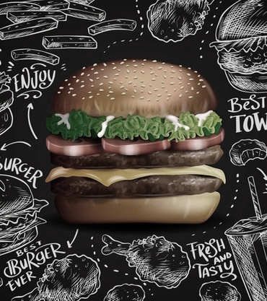
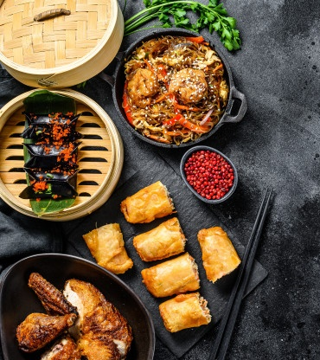
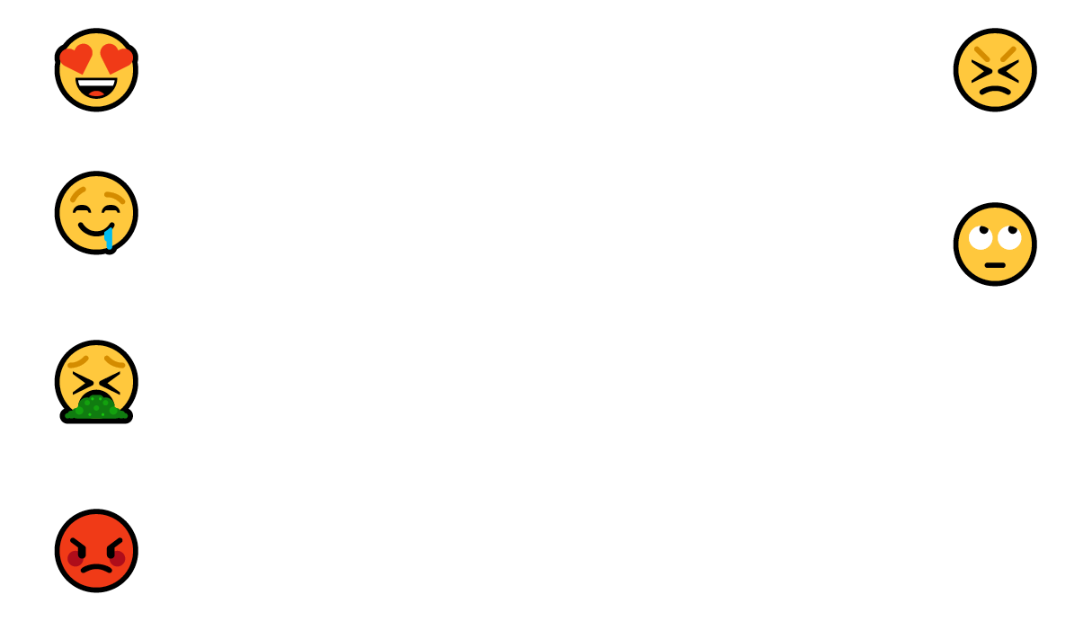
1
0
I like burgers
I hate Chinese food
There’s a burger restaurant! I’ll have a try!
There’s a Chinese restaurant, I definitely don’t want to have a try.
The burger from that restaurant is disgusting!
I’ll post a 1 star review for that restaurant on Yelp.

Slide 22
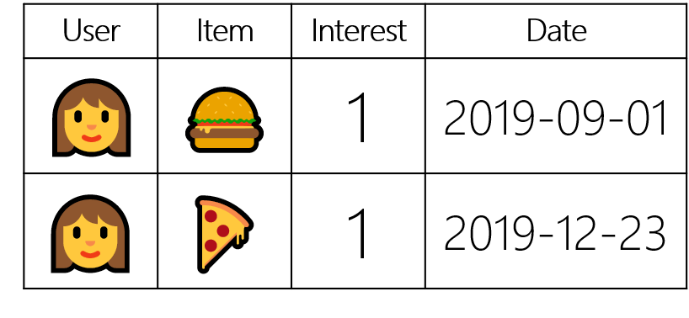
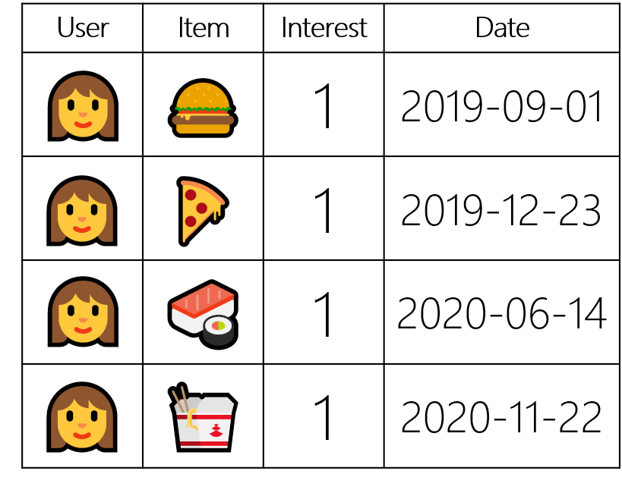
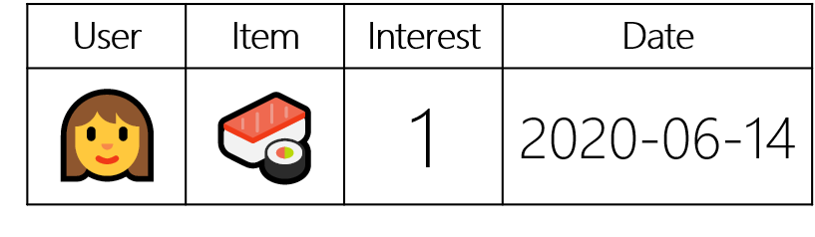
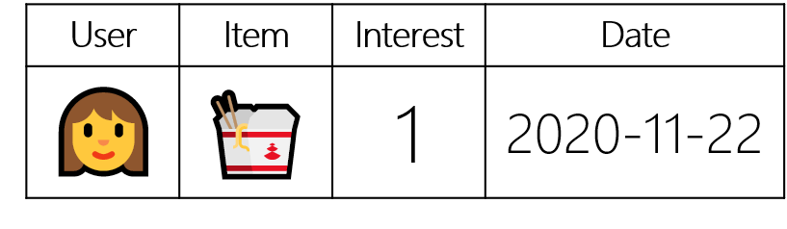
Evaluation
Train-Validation-Test Split
Put the latest review of each user into the test set, put the second latest review of each user into the validation set, the other reviews are in the training set.
Training
Validation
Test
Toronto Restaurant Recommender System
Presented by Jiangning Luo and Hang Gong

Slide 23
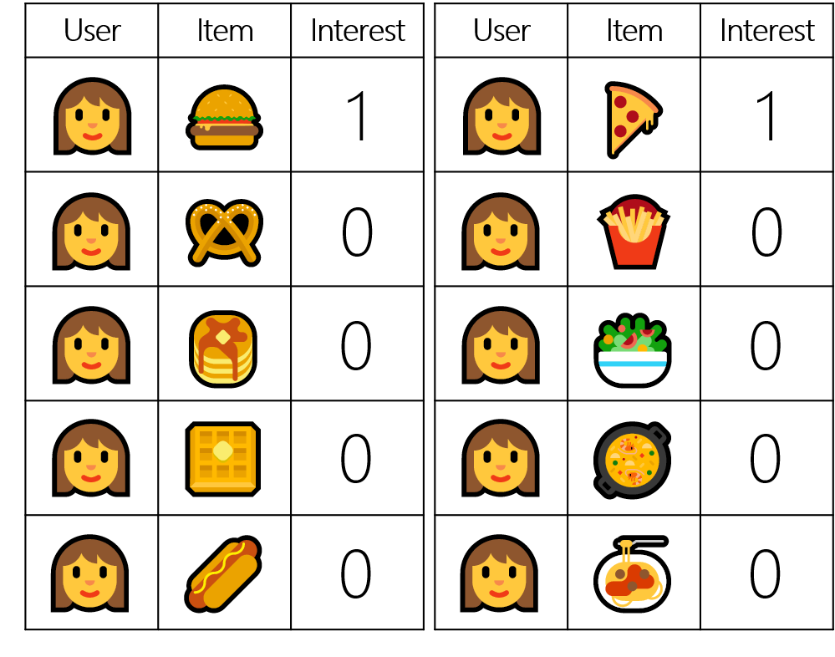
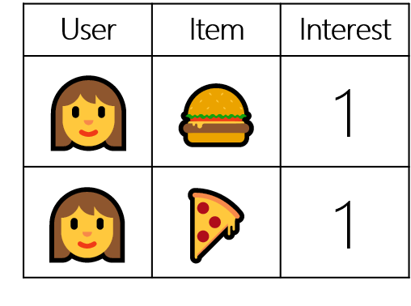
Evaluation
Training Set
For each review in the training set, randomly sample 4 restaurants that have not been reviewed by the user as not interested.
Toronto Restaurant Recommender System
Presented by Jiangning Luo and Hang Gong
Notes:
For now, all of the interactions are interested, to train our model, we also need not interested interactions.

Slide 24
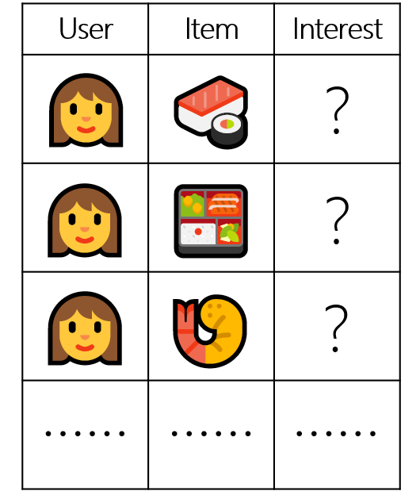
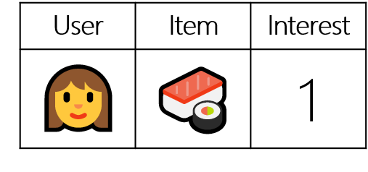
Evaluation
Validation and Test Set
For each user in the validation and test set, randomly sample 99 restaurants that have not been reviewed by the user as unknown interactions.
Toronto Restaurant Recommender System
Presented by Jiangning Luo and Hang Gong
Notes:
For now, all of the interactions are interested, to train our model, we also need not interested interactions.

Slide 25

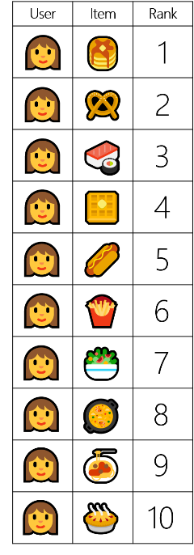
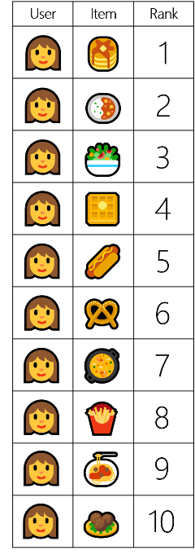
Evaluation
Evaluation Metric
Reviewed Item
During the evaluation, for each user, recommend 10 items that he/she will be most interested in from the validation set and the test set.
The performance is judged by Hit Ratio (HR).
The HR is the percentage of users that have the reviewed restaurant in their top 10 recommendations.
Hit
Not Hit
Toronto Restaurant Recommender System
Presented by Jiangning Luo and Hang Gong

Slide 26
Evaluation
Performances
Performances on the validation set
Performances on the validation set and the test set
0.49
0.51
0.44
0.47
Toronto Restaurant Recommender System
Presented by Jiangning Luo and Hang Gong
Notes:
We can see that Neural Matrix Factorization have better hit ratio and converges much faster than classical Matrix factorization

Slide 27
PART 5
Showcase & Summary
Toronto Restaurant Recommender System
Presented by Jiangning Luo and Hang Gong

Slide 28
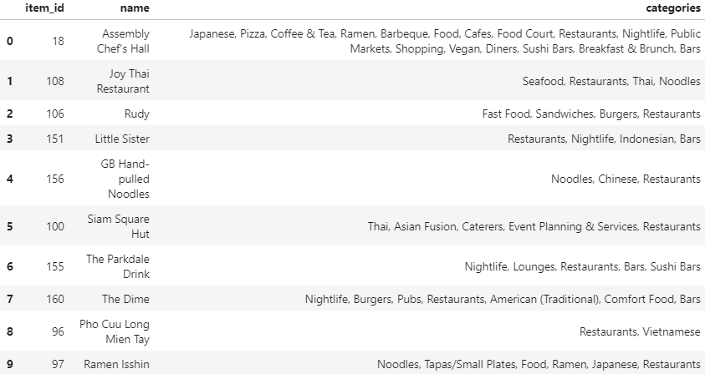
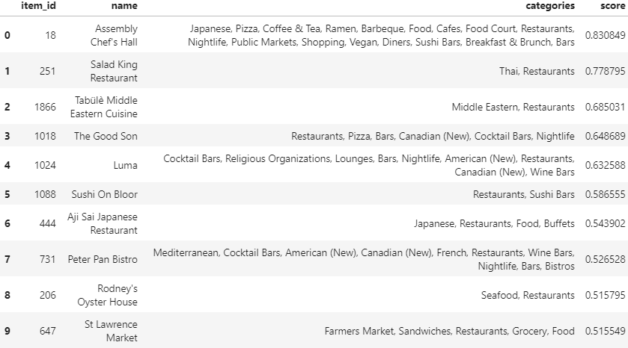
Showcase & Summary
Showcase
Last reviewed restaurants of a user
Top 10 recommendation from NCF to the user
Toronto Restaurant Recommender System
Presented by Jiangning Luo and Hang Gong

Slide 29
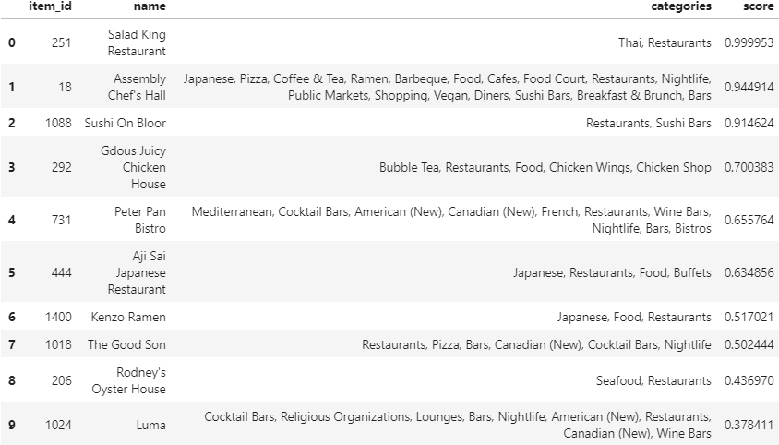
Showcase & Summary
Showcase
Last reviewed restaurants of a user
Top 10 recommendation from MF to the user
Toronto Restaurant Recommender System
Presented by Jiangning Luo and Hang Gong

Slide 30
Showcase & Summary
Pros and Cons of NCF
Pros:
Large level of flexibility and non-linearity
Converges faster
Better accuracy
Cons:
Higher computational cost
Slower implementation (60% more running time per epoch on GTX1060)
Toronto Restaurant Recommender System
Presented by Jiangning Luo and Hang Gong

Slide 31
Thank You!

